Slide 1

Chapter 5
Consumption and Exchange
Notes:
For a better classroom presentation flow, the order of some topics in this lecture outline differs slightly from the order of topics in the text and, where this occurs, some figures and tables are out of numerical order.

Slide 2
Learning Objectives
5.1 Recognize what is consumption in a cross-cultural perspective.
5.2 Identify the varieties of exchange in cross-cultural perspective.
5.3 Illustrate how consumption and exchange are changing.

Slide 3
Culture and Consumption
5.1 Recognize what is consumption in a cross-cultural perspective.
What Is Consumption?
Modes of Consumption
Consumption Funds
Theorizing Consumption Inequalities
Forbidden Consumption: Food Taboos

Slide 4
What Is Consumption?
The dominant way, in a culture, of using up goods and services
Two processes:
  A person’s “intake” in terms of eating or other ways of using things up
  “Output” in terms of spending or using resources to obtain those things

Slide 5
Modes of Consumption (1 of 3)
Related to modes of livelihood
Based on the relationship between demand and supply
Two major modes:
  Minimalism—characterized by few and finite consumer demands and adequate and sustainable means to achieve them
  Consumerism—people’s demands are many and infinite, and the means of satisfying them are never sufficient

Slide 6
Modes of Consumption (2 of 3)
Consumption varies cross-culturally
  Foragers are generally egalitarian
    Sharing within the group is the norm
    Everyone has equal access to all resources
  Most agricultural and industrial/digital societies exhibit consumption inequalities, some severe

Slide 7
Modes of Consumption (3 of 3)
Leveling mechanism:
  An important process in small-scale societies that works to keep people equal
  Unwritten, culturally embedded rules that prevent an individual from becoming wealthier or more powerful
  Maintained through social pressure and gossip

Slide 8
Consumption Funds
Consumption fund:
  Category of a personal or household budget used to provide for consumption needs and desires
  Five consumption funds:
    Basic needs fund
    Recurrent costs fund
    Entertainment fund
    Ceremonial fund
    Rent/tax fund

Slide 9
Theorizing Consumption Inequalities
(1 of 2)
Entitlement:
  A culturally defined right to life-sustaining resources
  Direct entitlement: secure access to life-sustaining resources
    Example: owning a farm able to produce food
  Indirect entitlement: life-sustaining resources must be gained through exchange
    Example: working for a wage to earn money to buy food

Slide 10
Theorizing Consumption Inequalities
(2 of 2)
Entitlement inequalities at three levels
  International
    The global economy means some countries are more secure than others
  State
    Those with direct entitlements may be more secure than those with indirect entitlements
  Household
    Some members are more secure than others

Slide 11
Consumption Microcultures (1 of 3)
Microcultures have distinct entitlement patterns
Social inequality may play an important role and affect human welfare
Examples:
  Class
  Gender
  “Race”/ethnicity

Slide 12
Consumption Microcultures (2 of 3)
Example: Gender Inequality and a Deadly Disease in Papua New Guinea
  1957–1977: many mysterious deaths, especially among women
  Cause found to be a neurological disease contracted through eating flesh of deceased people
  Women were more deprived of dietary protein from pork, as men get the better food
  Women resorted to cannibalism
  Sometimes ate contaminated corpses, thus contracting the disease kuru

Slide 13
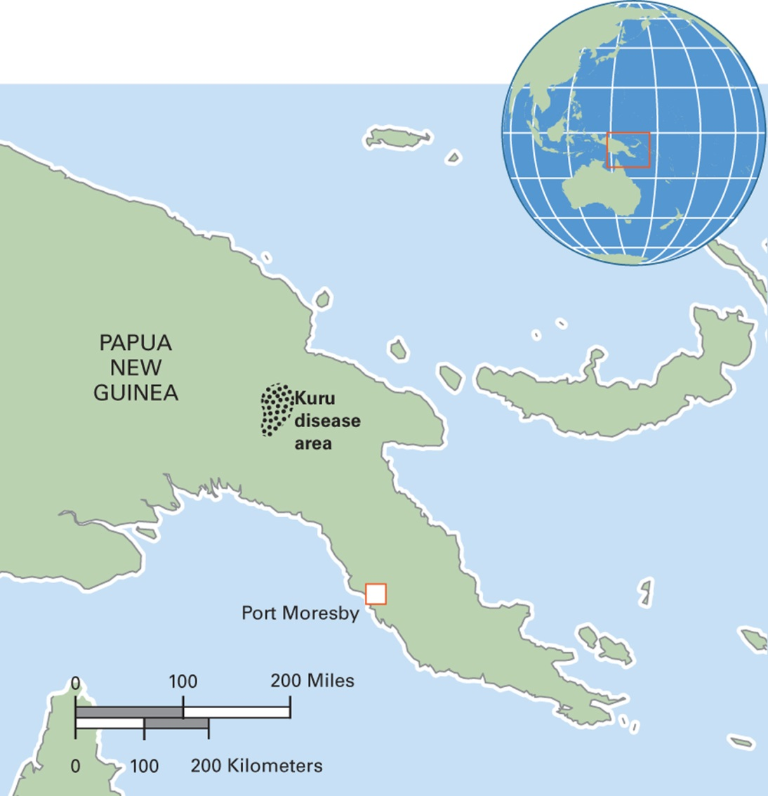
Map 5.1 Location of the Kuru Epidemic in Papua New Guinea

Slide 14
Consumption Microcultures (3 of 3)
Example: “Race” and Children’s Shopping Patterns
  Study in New Haven, Connecticut
  Low-income neighborhood of African Americans
  Children have little money to spend and strong emphasis on family sharing
  Shopping choices guided by practicality and generosity

Slide 15
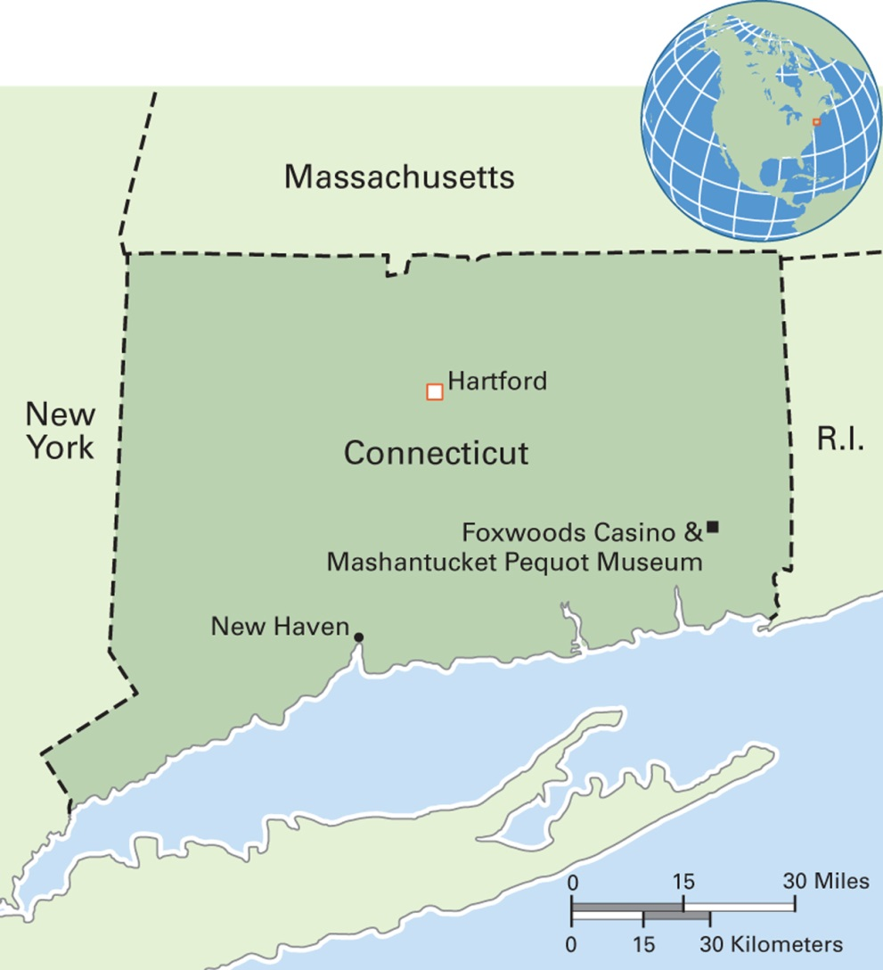
Map 5.2 Connecticut, United States
Notes:
In terms of per capita income, Connecticut is the wealthiest state in the United States. Its population of about 3.6 million includes a majority of Whites (nearly 80 percent), predominantly of Italian, Irish, and English descent. Blacks and Latinos constitute about 10 percent of the population each. Indian tribal peoples are 0.3 percent. Other ethnic groups constitute the rest of the population.

Slide 16
Forbidden Consumption: Food Taboos
Case study: Jewish and Muslim taboos on eating pig meat
  Cultural materialist argument:
    Can be explained ecologically: Pigs unsuited to arid climates and local modes of livelihood (Harris)
  Symbolic/interpretivist argument:
    Can be explained as a communication of meaning: Pigs’ physiology renders them symbolically anomalous and therefore impure (Douglas)

Slide 17
Culture and Exchange
5.2 Identify the varieties of exchange in cross-cultural perspective.
What Is Exchanged?
Modes of Exchange

Slide 18
What Is Exchanged? (1 of 2)
Exchange:
  The dominant way, in a culture, of transferring goods, services, and other items between and among people and groups

Slide 19
What Is Exchanged? (2 of 2)
What do people exchange?
  Material goods (food, gifts)
  Symbolic goods
    Example: myths in the Balgo Hills, Australia
  Labor
  Money (symbolic or material?)
  People (slavery, offspring in marriage)
  Other?

Slide 20
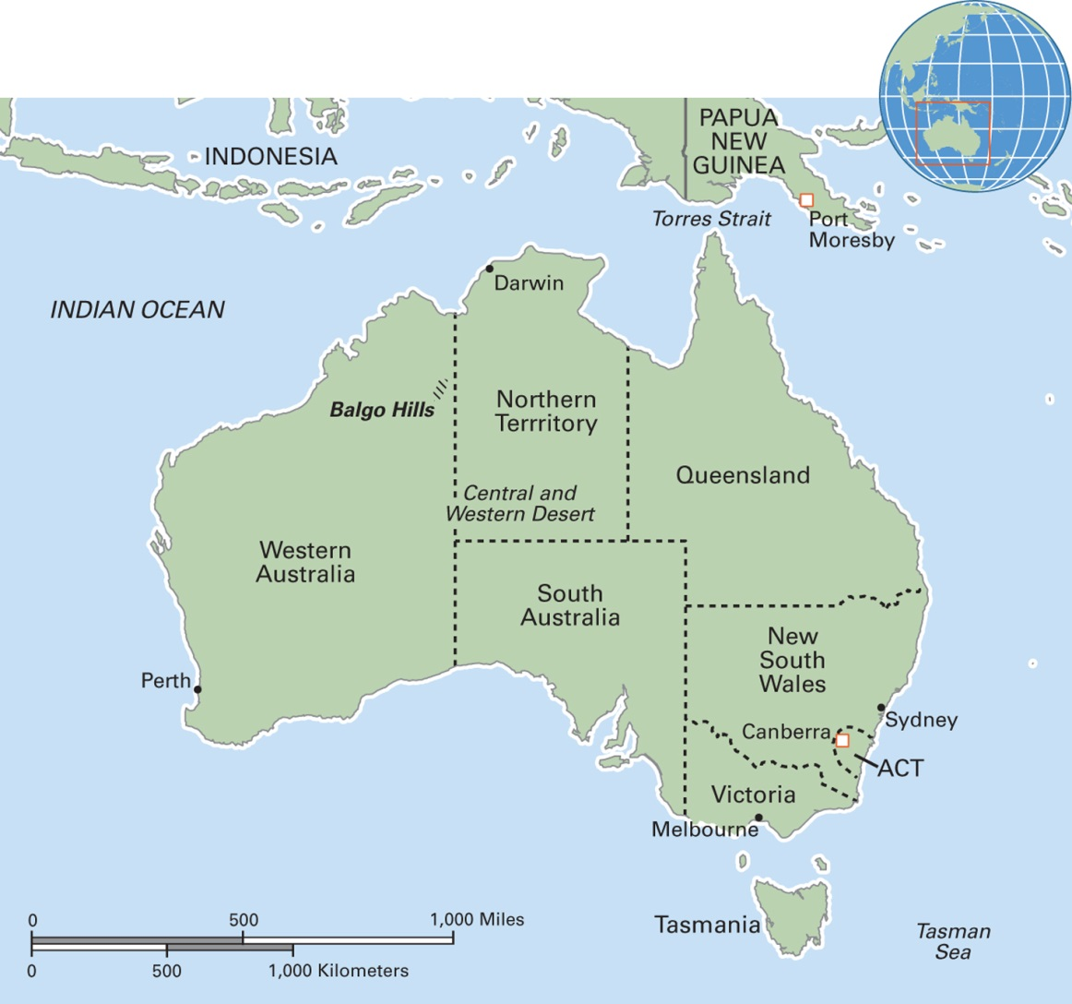
Map 5.5 The Balgo Hills (Wirrimanu) Region in Western Australia
Notes:
The Balgo Hills community is located on the northern edge of the Tanami and Great Sandy Deserts. One of Australia’s most isolated indigenous desert settlements, it nevertheless has a flourishing art center. Balgo paintings and glass are highly sought after by collectors.

Slide 21
Think Like an Anthropologist:
The Rules of Hospitality
In Oman, women’s main social activity is visiting other women in their homes
Social etiquette dictates what is served
  Coffee and dates; cookies, candy, and popcorn
Number of dishes also important
  Single dish for close neighbors
  At least two dishes for all other visitors
Guests should leave about half of the food served to them
How do these Omani rules of hospitality resemble or contrast with your rules of hospitality?

Slide 22
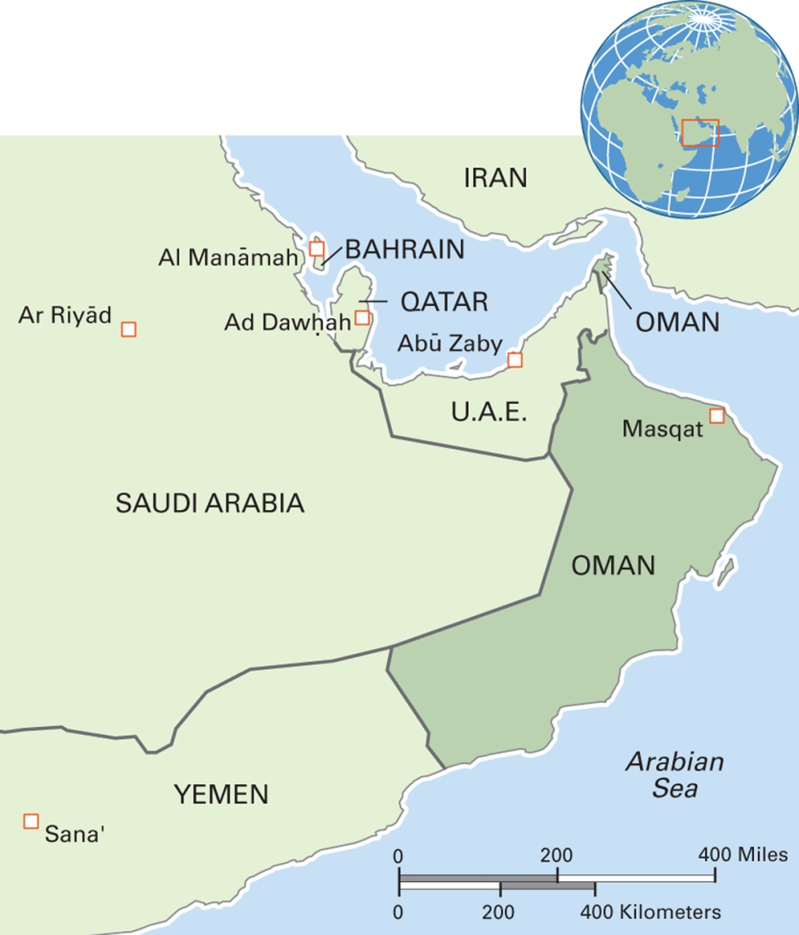
Map 5.4 Oman
Notes:
The Sultanate of Oman is mainly a vast desert plain with a hot, dry climate. The population of nearly 3 million includes around 900,000 immigrant laborers. The economy is based mainly on crude oil. The major religion is Ibadi Islam, a more liberal version of Islam than Sunni or Shi’a Islam. Arabic is the official language, with English a widely spoken second language. Several dialects of Arabic are spoken.

Slide 23
Modes of Exchange (1 of 4)
Balanced exchange
  Generalized reciprocity
    Pure gift
  Expected reciprocity
  Redistribution
Unbalanced exchange
  Market exchange
  Gambling
  Theft
  Exploitation

Slide 24
Modes of Exchange (2 of 4)
Balanced exchange: generalized reciprocity
  Involves the least conscious sense of interest in material gain or of what might be received in return
  Main form of exchange in foraging societies
  Also found among close kin and friends cross-culturally
  A pure gift is an extreme form

Slide 25
Modes of Exchange (3 of 4)
Balanced exchange: expected reciprocity
  Exchange of approximately equally valued goods or services between people of roughly equal social status
  Exchange may be simultaneous or on an agreed-upon schedule
  If a party fails to complete the exchange, the relationship will break down

Slide 26
Modes of Exchange (4 of 4)
Unbalanced exchange: market exchange
  The buying and selling of commodities under competitive conditions in which the forces of supply and demand determine value and the seller seeks to make a profit
  Ranges from informal (periodic market) to huge shopping centers (permanent market)

Slide 27
Anthropology Works: Evaluating the Social Effects of Indian Gaming (1 of 2)
Research to evaluate the social and economic effects of Indian gaming operations on tribal and local governments in California
Two key factors in determining if benefits are locally felt by Indians:
  If casinos are owned by tribal governments
  If casinos are located on existing tribal trust lands

Slide 28
Anthropology Works: Evaluating the Social Effects of Indian Gaming (2 of 2)
Gaming in California led to greater economic inequality between gaming and nongaming reservations
Revenue Sharing Trust Fund was created to counteract this effect
Gaming benefits the communities beyond the reservation as well

Slide 29
Consumption, Exchange, and Global-Local Relations (1 of 2)
5.3 Illustrate how consumption and exchange are changing.
Sugar, Salt, and Steel Tools in the Amazon
Global Networks and Ecstasy in the United States
Global Demand for Phosphates Eats an Island
Alternative Food Movements in Europe and North America
The Enduring Potlatch

Slide 30
Consumption, Exchange, and Global-Local Relations (2 of 2)
Trends
  Increasing power of globalization in shaping consumption and exchange
  Some examples of resistance by local cultures to the global economy

Slide 31
Sugar, Salt, and Steel Tools in the Amazon
Growing attachment to commodities such as sugar, salt, and steel tools
Involvement with cash economy to obtain such goods
Declining diet and nutrition

Slide 32
Global Networks and Ecstasy in the United States
Since 1990s, rise in use of ecstasy in the United States
Fieldwork study in Baltimore, Maryland
Global supply chain

Slide 33
Global Demand for Phosphate
Eats an Island
Phosphate is used for fertilizer
Banaba Island, in the Republic of Kiribati, is rich source of phosphate
90 percent of the surface has been removed by mining; most residents displaced

Slide 34
Alternative Food Movements in Europe and North America
Seek to reestablish direct links between food producers, consumers, and marketers
Promote locally grown, not mass-produced food
Example: Italy’s Slow Food Movement

Slide 35
The Enduring Potlatch
Resurgence of group feasting and exchange in recent times among native peoples of the Northwest Coast region
Potlatching had been banned by the Canadian government from 1884 to 1951

Slide 36
Culturama: The Kwakwaka’wakw of Canada
A cluster of 20 linguistically related groups of Canada’s Pacific Northwest region
Means “the people who speak Kwak’wala”
Famous for aspects of their material culture
  Tall, carved wooden totem poles
  Canoes, masks, and serving bowls
  Richly decorate capes, skirts, and blankets

Slide 37
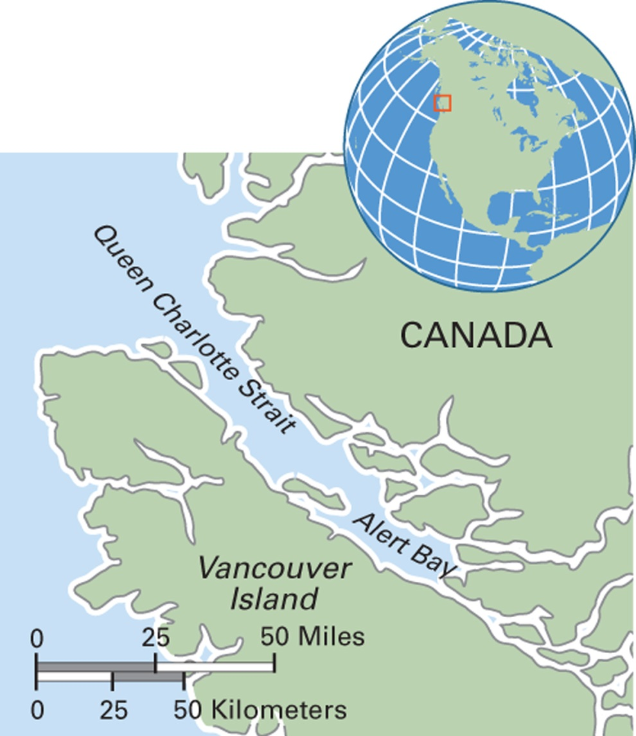
Map 5.7 Kwakwaka’wakw
Region in Canada
Notes:
The Kwakwaka’wakw are a Pacific Northwest Coast indigenous people. Their current population is approximately 5,500. Most live in British Columbia on northern Vancouver Island and the adjoining mainland. Some live outside their homelands in urban areas such as Victoria and Vancouver. Their language, now spoken by about 250 people, consists of four dialects. They are organized into 13 band governments.

